Slide 1
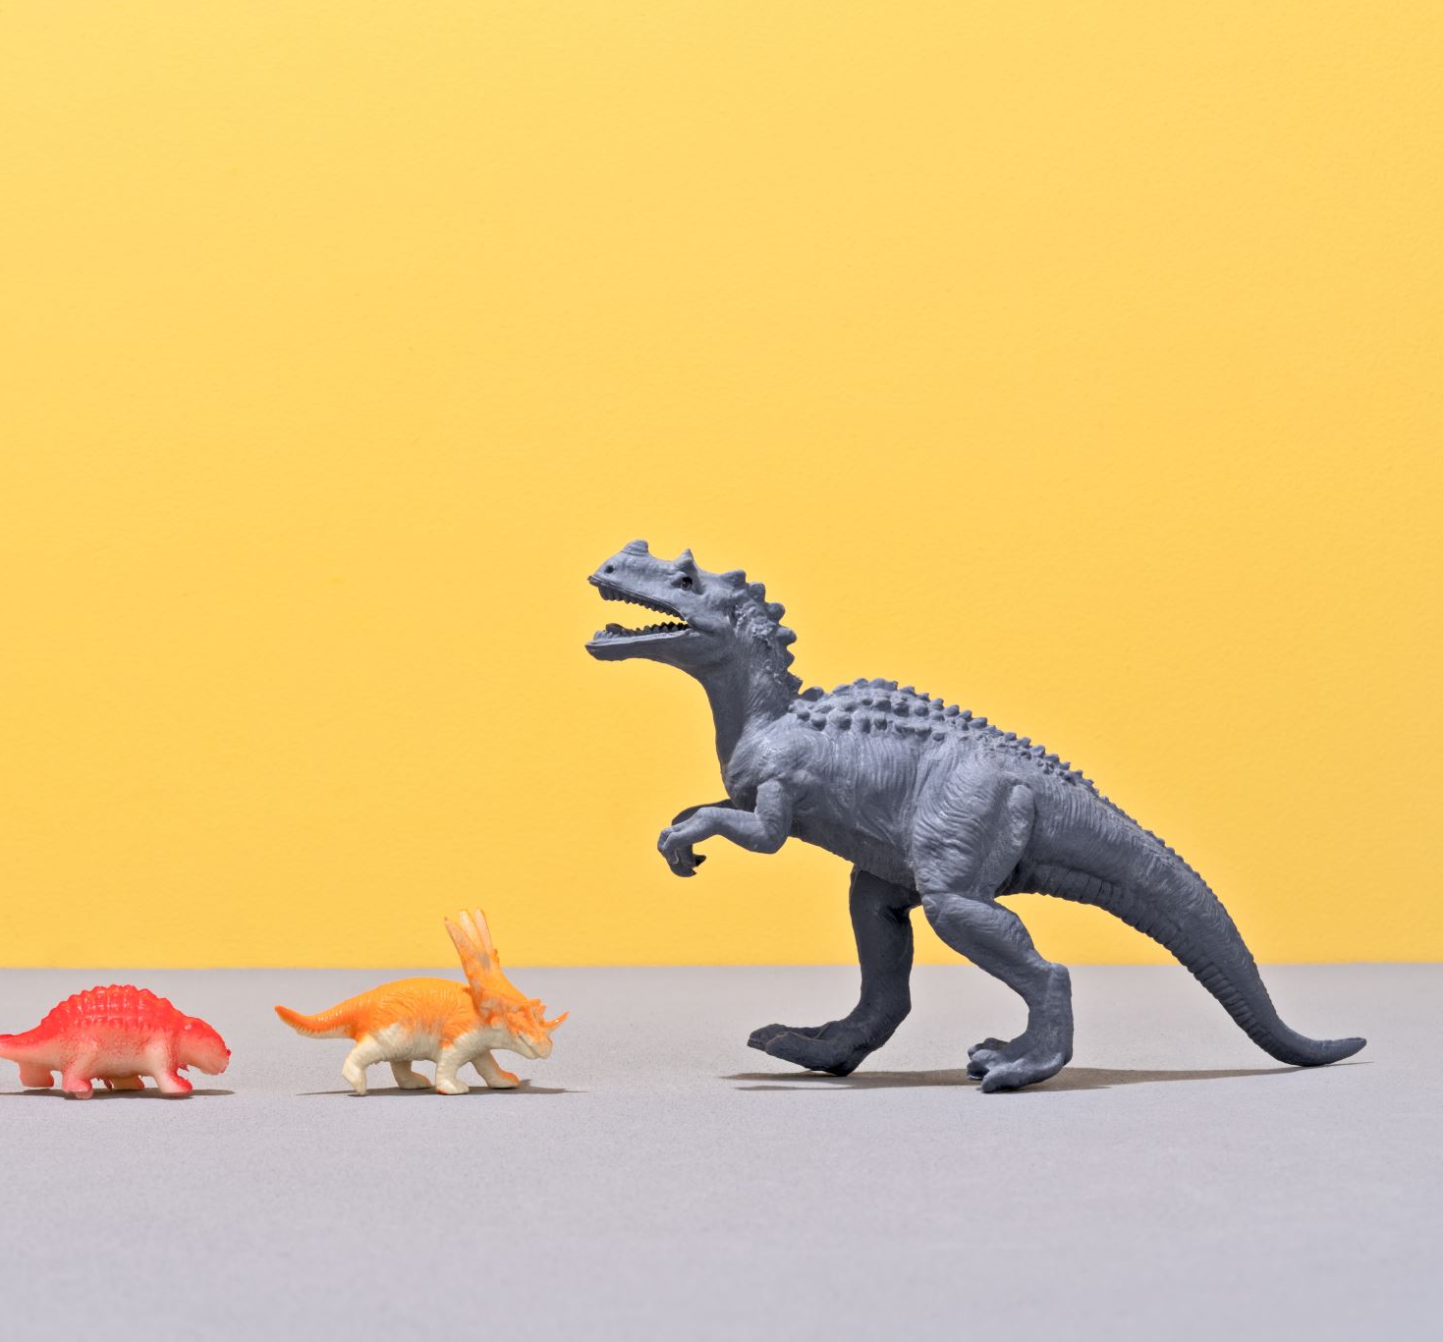
Dinosaur action figure Scene
By Ryan

Slide 2
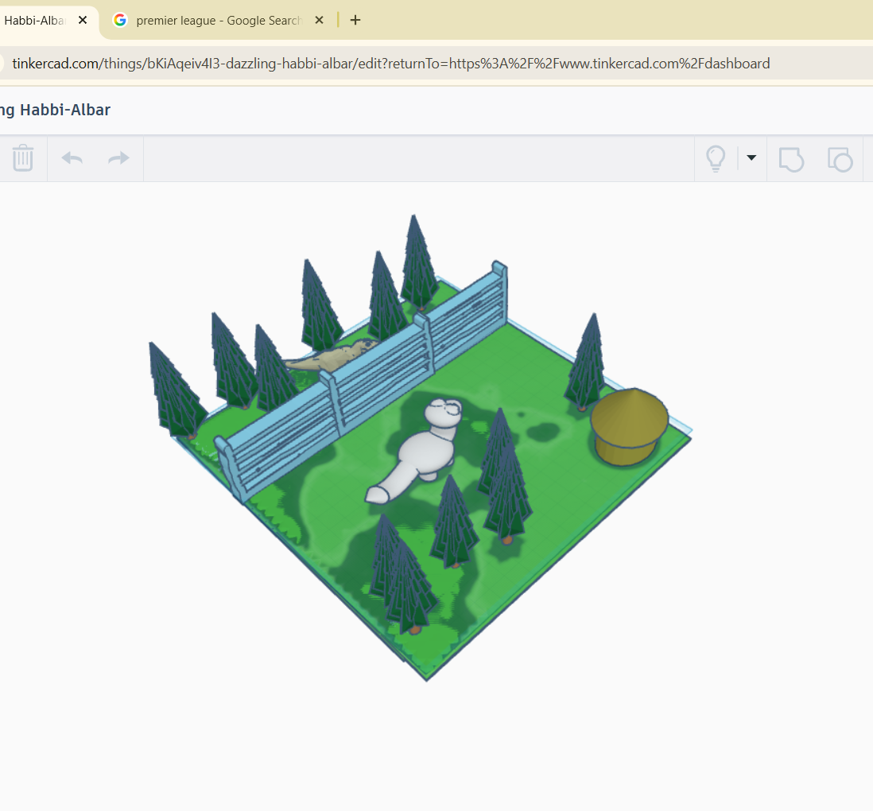
The Picture of the Dinosaur Scene

Slide 3
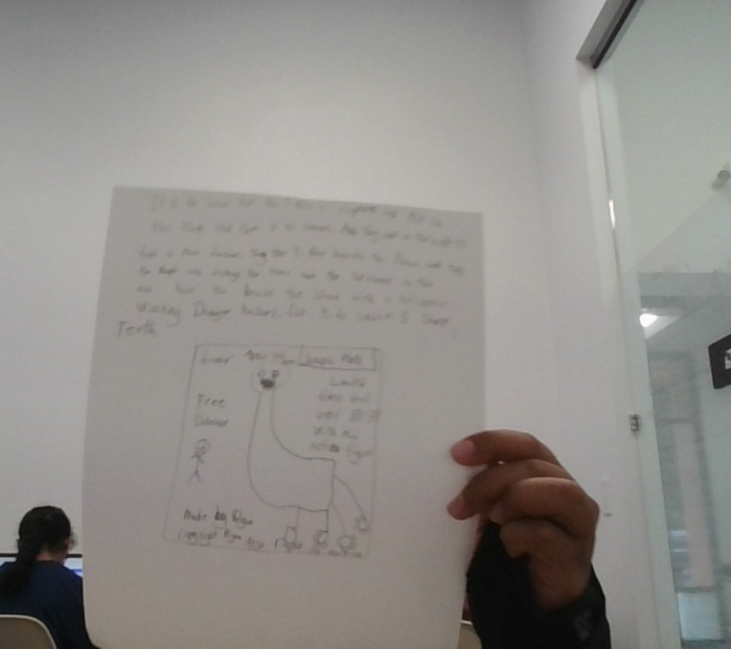
Collectable item and Marketing Poster
It is a T-rex from the Jurassic Park Movie and the one that ate some people and saved the people in the Jurassic world and yeah. Danger Hazard for kids under the age of 5 Teeth hazard

Slide 4
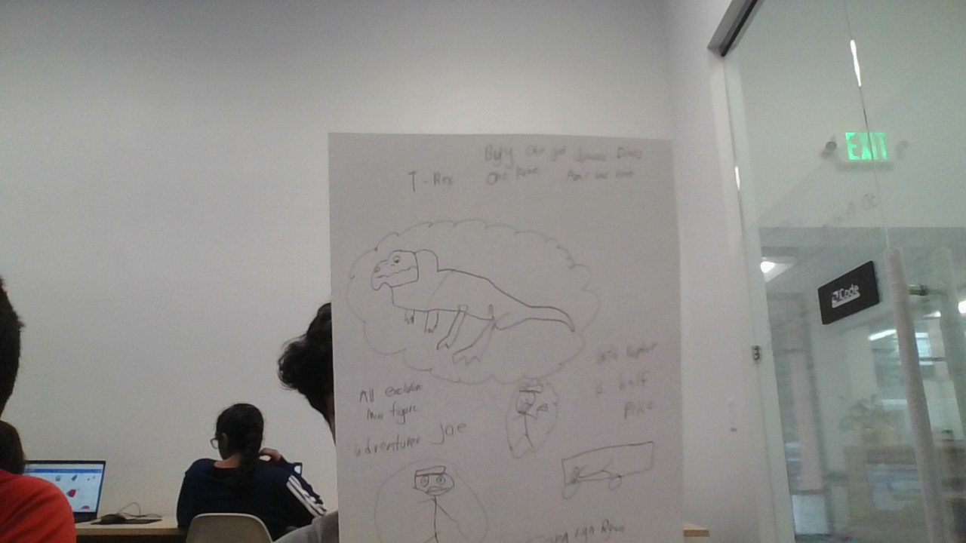
Commercial Storyboard

Slide 5

Thank you for listening

